Slide 1
Tree-based methods of machine learning
V. Lyubchich

Slide 2
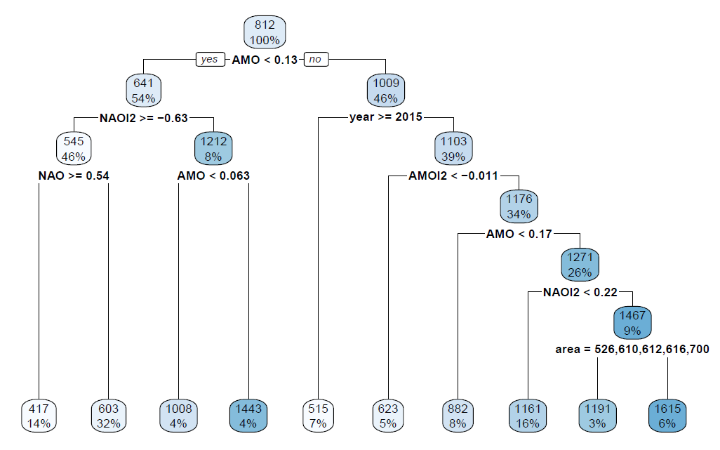
CART = Classification and Regression Tree
splitting
rules
nodes
average response
% of the sample
terminal
nodes

Slide 3
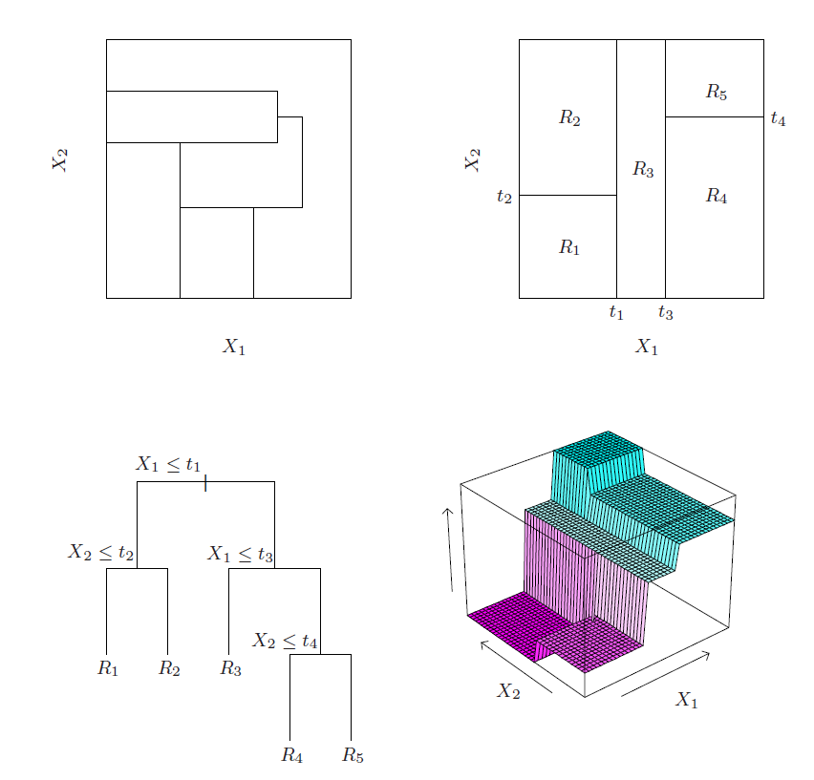
Partitions in CART

Slide 4
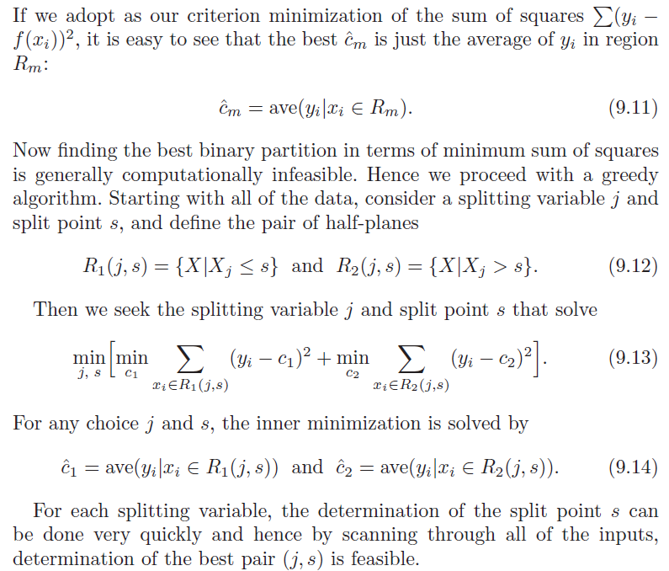

Slide 5
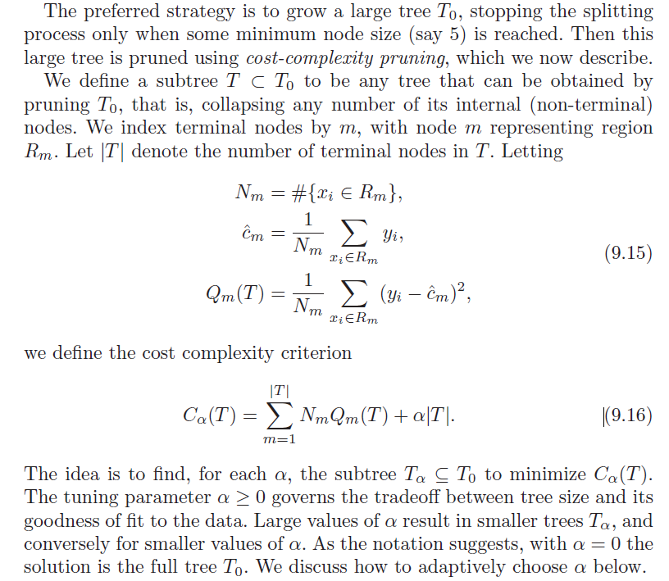

Slide 6


Tree Problems
Instability of trees
Lack of smoothness
Difficulty in capturing additive structure
For example,
Income = $10 I(age > 18) + $30I(schoolyrs >12)
has 2 thresholds, but CART would likely need 3.

Slide 7
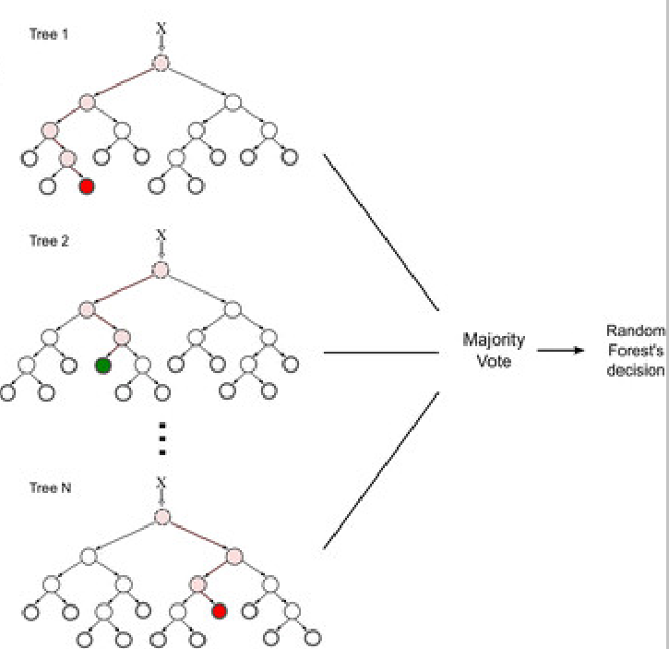
Random Forest (bagging = bootstrap aggregation)
B

Slide 8
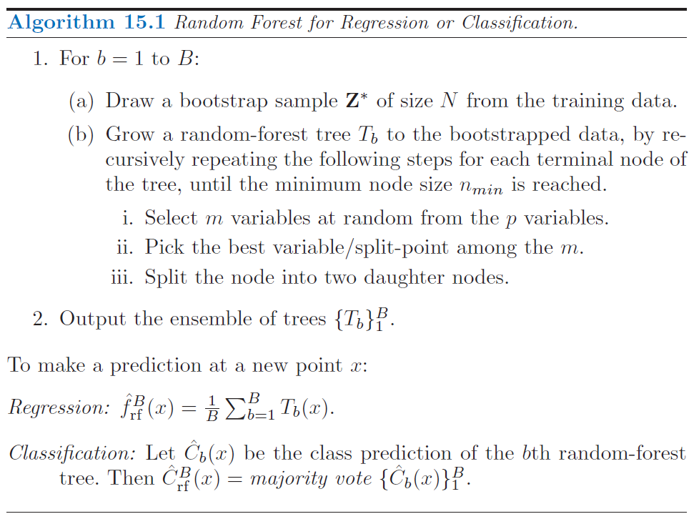

Slide 9
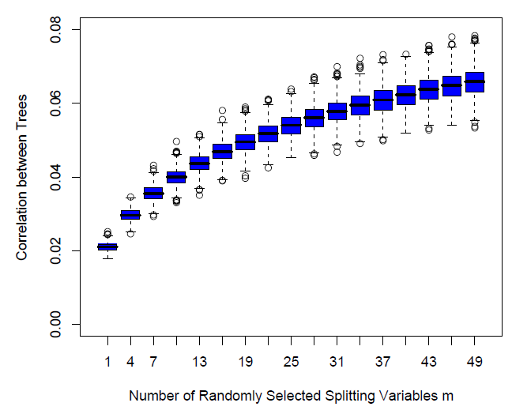
Decorrelation

Slide 10
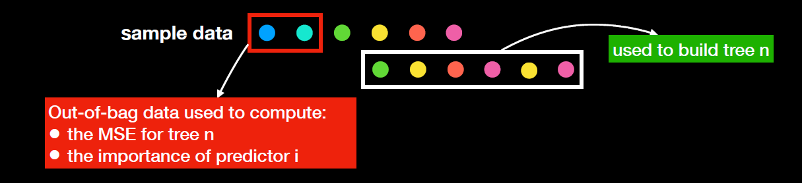
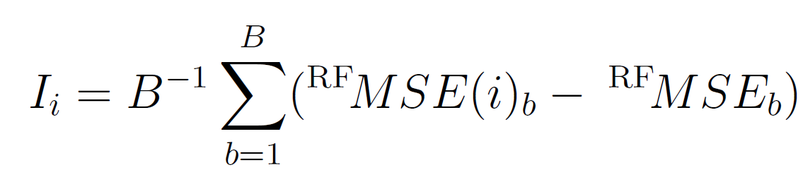
Random Forest = many trees
Bootstrap sample of data cases (sample with replacement, of the same size as the original)
b
b
At each split, subsample (sample without replacement, smaller than the original, about 1/3)
variables for consideration,
to make trees more different from one another.

Slide 11
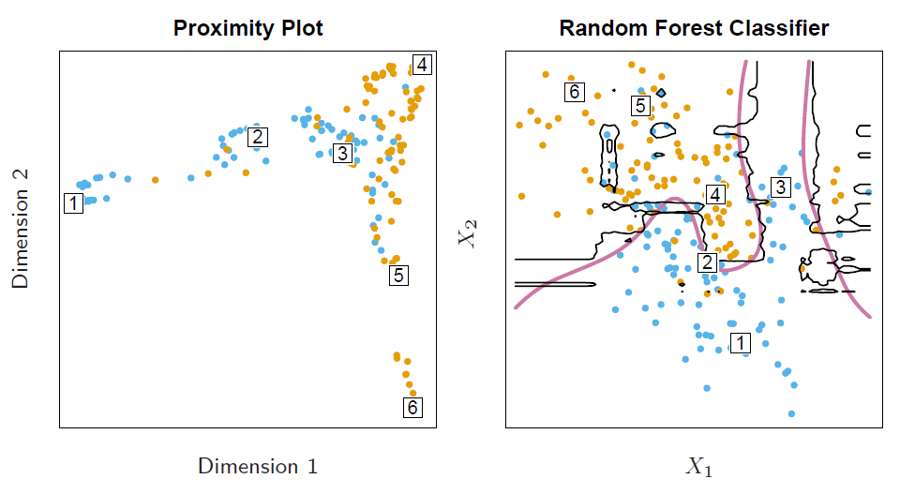
Proximity Plot
In growing a random forest, an N × N proximity matrix is accumulated for the training data. For every tree, any pair of oob observations sharing a terminal node has their proximity increased by one. This proximity matrix is then represented in two dimensions using multidimensional scaling. The idea is that even though the data may be high-dimensional, involving mixed variables, etc., the proximity plot gives an indication of which observations are effectively close together in the eyes
of the random forest classifier.

Slide 12
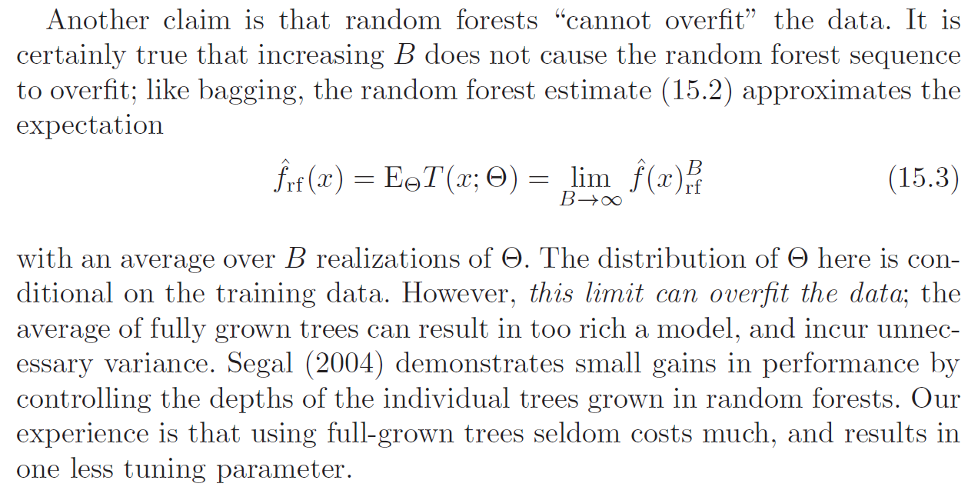
Random Forests and Overfitting

Slide 13
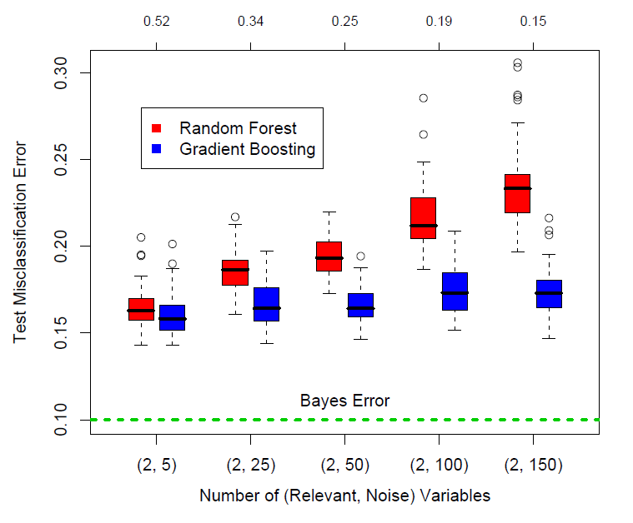
RF v. Gradient Boosting

Slide 14
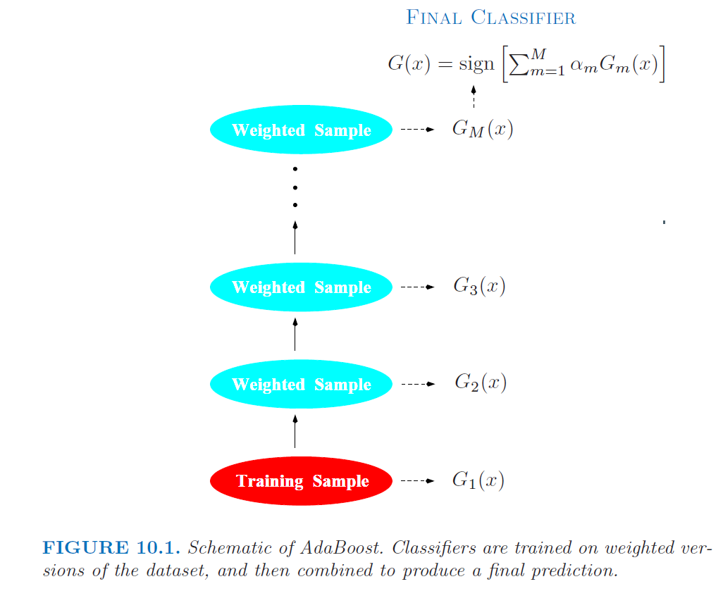
AdaBoost

Slide 15
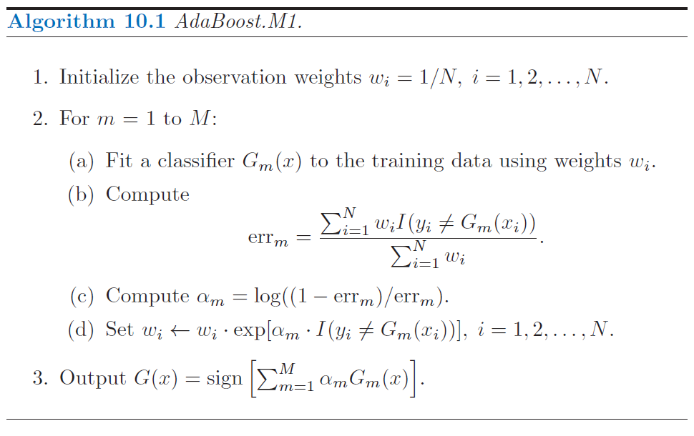

Slide 16
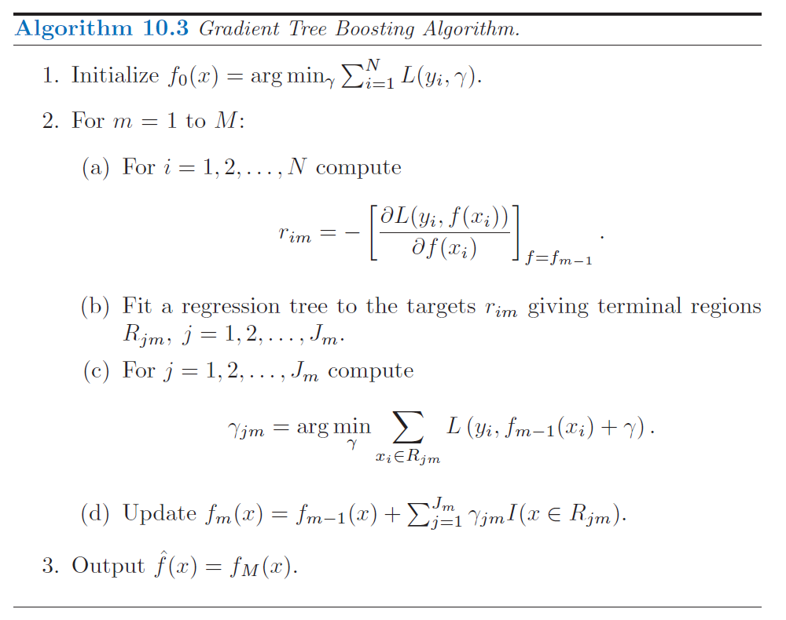

Slide 17
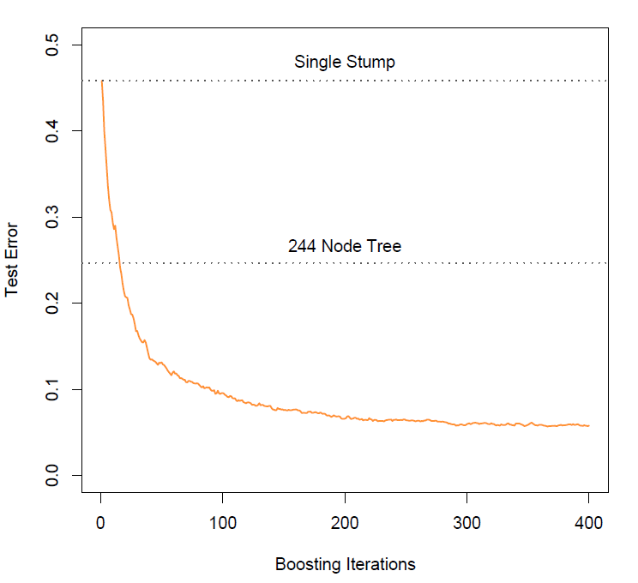

Slide 18
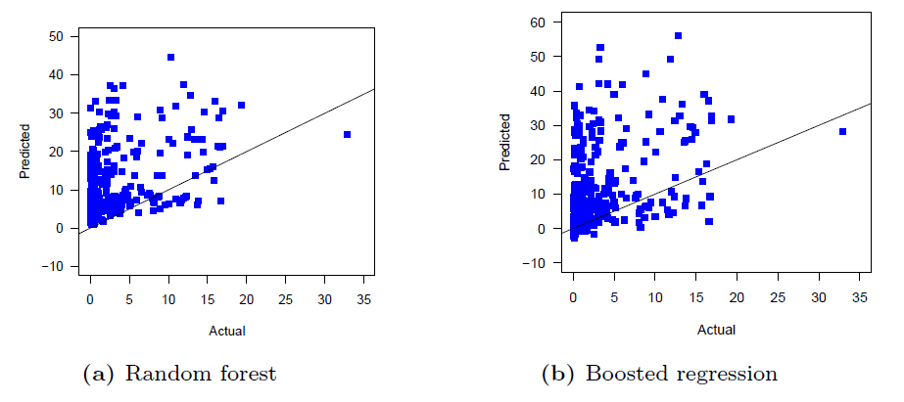
Examples
For random forest, use R packages randomForest (has partial dependence plots) and ranger (much faster, has options to calculate p-values for variable importance).

Slide 19
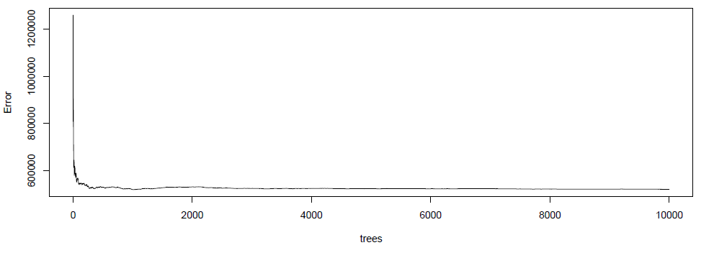
set.seed(300000)
rf2 <- randomForest(y = DATAnoNA[,RESPONSE],
x = DATAnoNA[, v])
print(rf2)
plot(rf2)

Slide 20
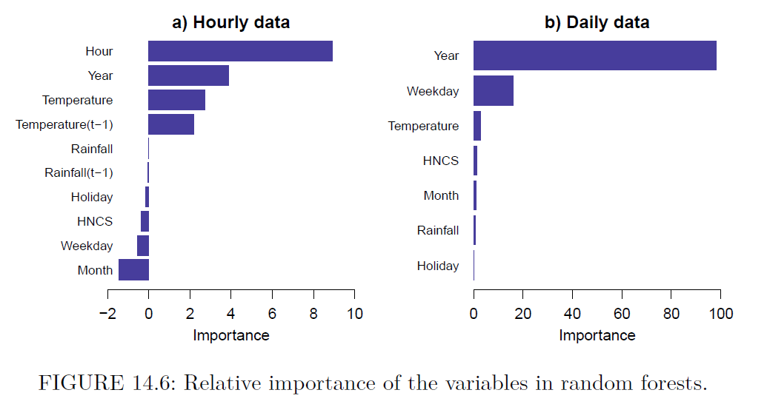

Slide 21
Example code: variable importance
set.seed(10000)
ran <- ranger(dependent.variable.name = RESPONSE, data = DATAnoNA,
importance = 'impurity_corrected',
min.node.size = 5, respect.unordered.factors = 'partition',
num.trees = 500)
#for predictions
ran2 <- ranger(dependent.variable.name = RESPONSE, data = DATAnoNA,
# importance = 'impurity_corrected',
min.node.size = 5, respect.unordered.factors = 'partition',
num.trees = 500)
print(ran)
ranimp <- importance_pvalues(ran, method = "altmann",
num.permutations = 500,
formula = as.formula(paste(RESPONSE, ".", sep = " ~ ")),
data = DATAnoNA)
ranimp <- ranimp[order(ranimp[,1]),]
tmp <- ranimp[,1]
barplot(tmp,
beside = TRUE, las = 1, #xlim = c(0, 20),
xlab = "Importance",
col = 1, border = NA, cex.names = 0.6,
horiz = TRUE)

Slide 22
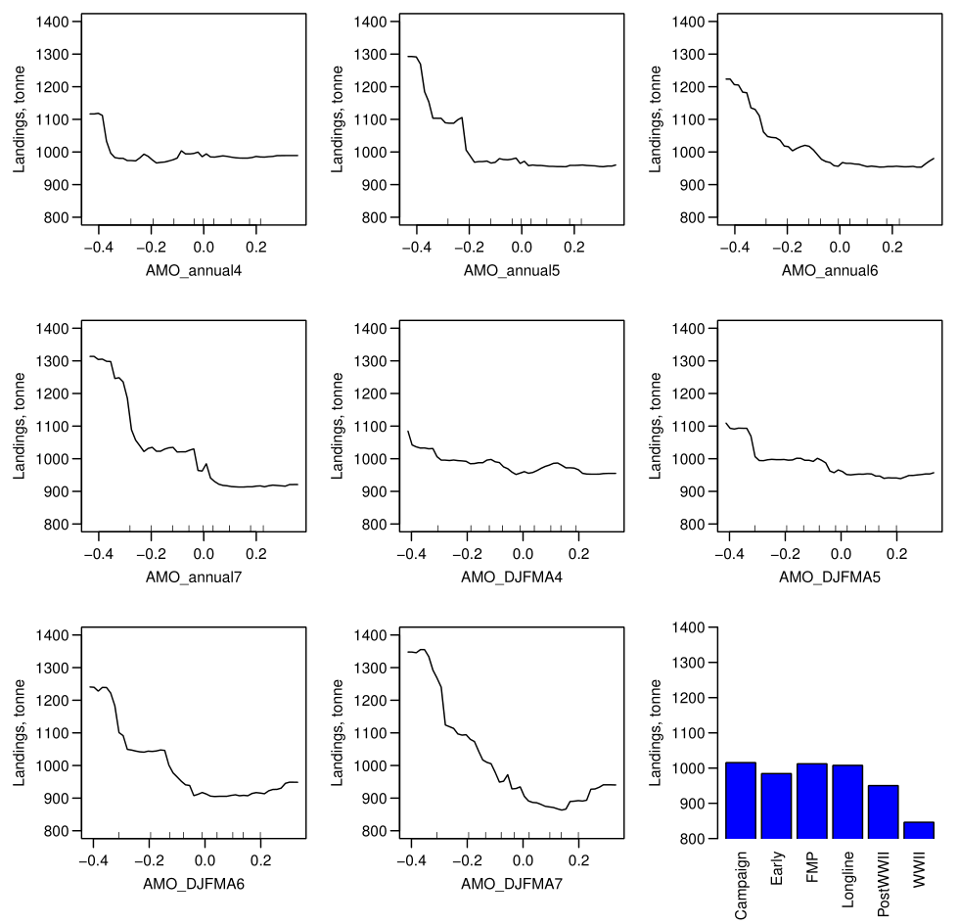
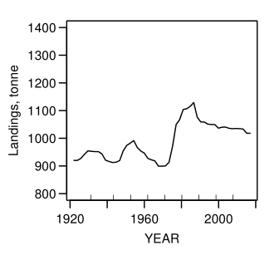
Partial Dependence Plots

Slide 23
Example code: partial dependence
set.seed(300000)
RF <- randomForest(y = DATAnoNA[,RESPONSE], x = DATAnoNA[, v])
preds <- sort(rownames(rf2$importance)) #get number of predictors
par(mfrow = c(ceiling(length(preds)/3), 3)) #set plots in 3 columns
par(bty = "L", mar = c(5, 4, 1, 1) + 0.1, mgp = c(2, 0.7, 0))
for(i in 1:length(preds)) {
if(preds[i] == "Time_Block") { #use different settings for categorical predictor(s)
partialPlot(RF, pred.data = Dtrain, x.var = preds[i],
las = 2, xlab = "", ylab = "", main = "", xpd = F
#,ylim = c(400, 3100)
)
} else {
partialPlot(RF, pred.data = Dtrain, x.var = preds[i],
las = 1, xlab = preds[i], ylab = "", main = "", xpd = F
#,ylim = c(0.55, 1.05)
)
}
}

Slide 24
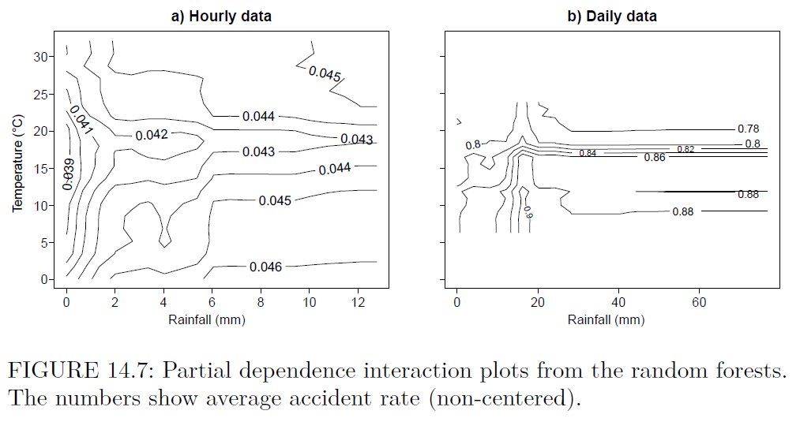
library(plotmo) #for interaction plots

Slide 25
To consider
Out-of-sample predictions
Cross-validation (for tuning hyper-parameters)

Slide 26
References
Breiman L, Friedman J, Stone CJ, Olshen RA. Classification and regression trees. CRC press; 1984.
Breiman L. Random forests. Machine learning. 2001;45(1):5-32.
Hastie T, Tibshirani R, Friedman J. The elements of statistical learning: data mining, inference, and prediction. Springer Science & Business Media; 2009.
Berk RA. Statistical learning from a regression perspective. 2nd ed. New York: Springer; 2016.

